Slide 1
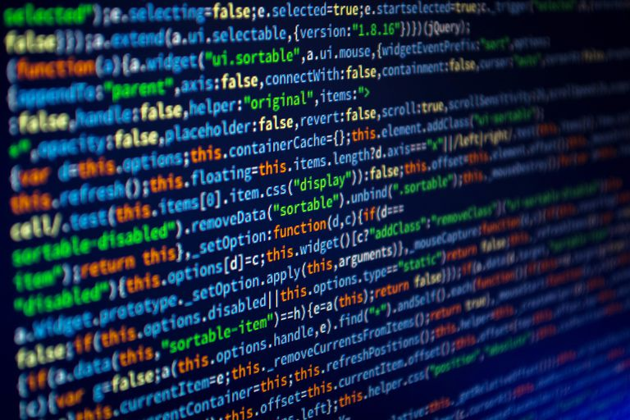
JavaScript Concepts
Hyland Tech Outreach

Slide 2

Functions
Notes:
Functions are kind of like commands you would give to your dog. You tell your dog to sit, and they know what to do! In JavaScript, commands to different things, like show messages.

Slide 3
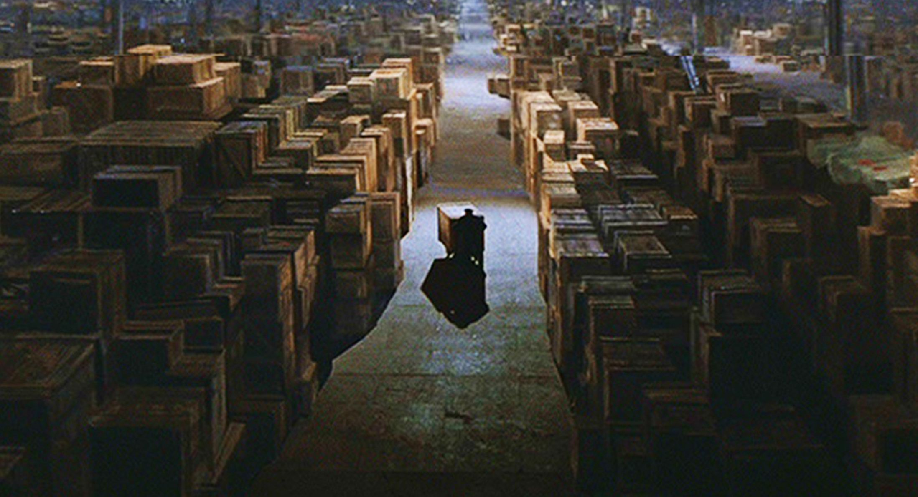
Variables
Notes:
Think of a computer’s memory as a giant warehouse. If memory is a giant warehouse...
…then a block of memory is the box
...and a value is the contents of a box
...and a variable is a label you stick on the outside of the box

Slide 4
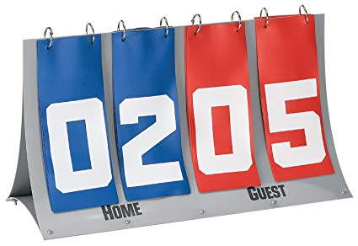
Variables Example
var bluePoints = 2;
var redPoints = 5;
bluePoints++;
Notes:
Ask the students what the score will be after the value of `bluePoints` is incremented

Slide 5
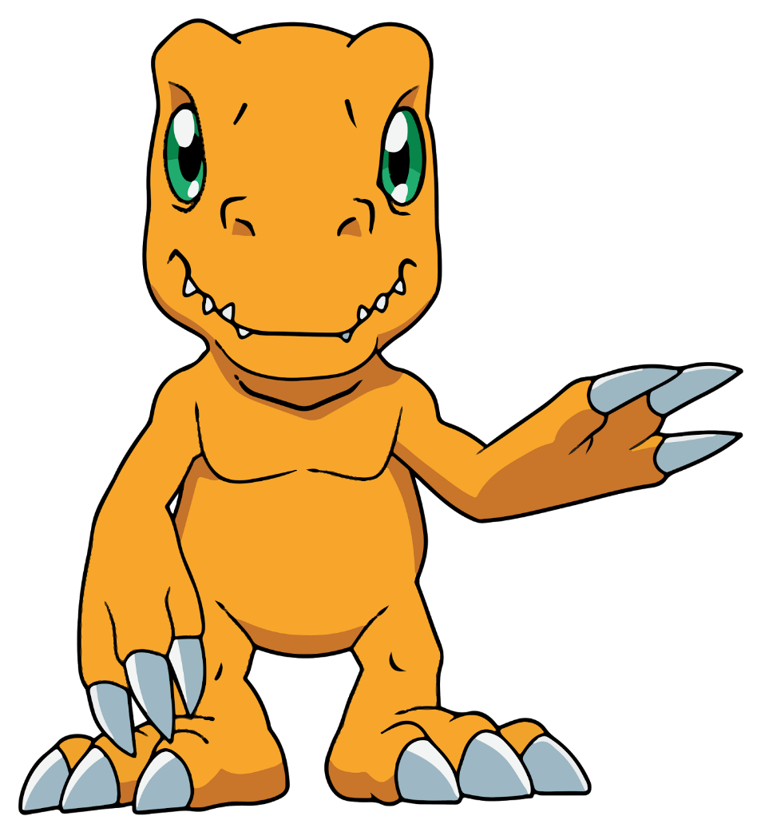
Variables Example 2
var yourName = "Alex"; alert("Hello " + yourName);
Hello Alex
Notes:
Ask the students what they think the `alert` will do

